Slide 1
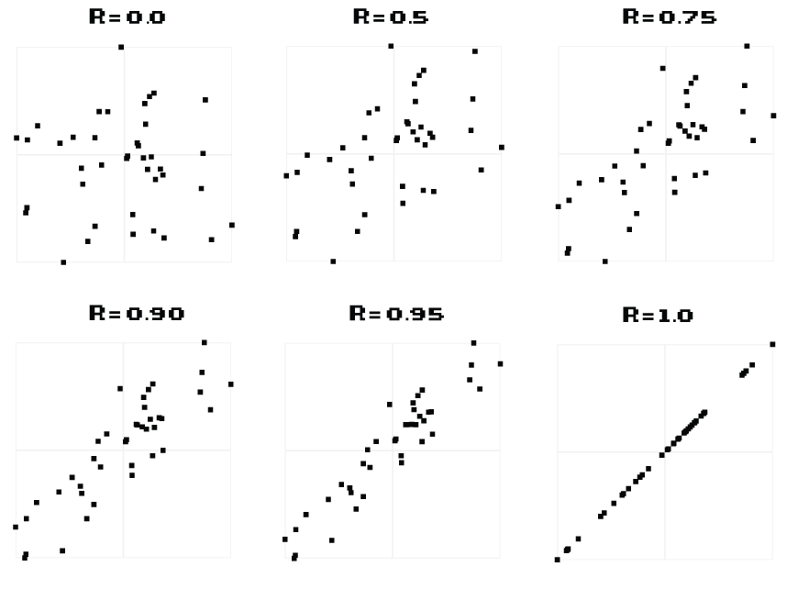
Arrange from weakest to strongest correlation

Slide 3
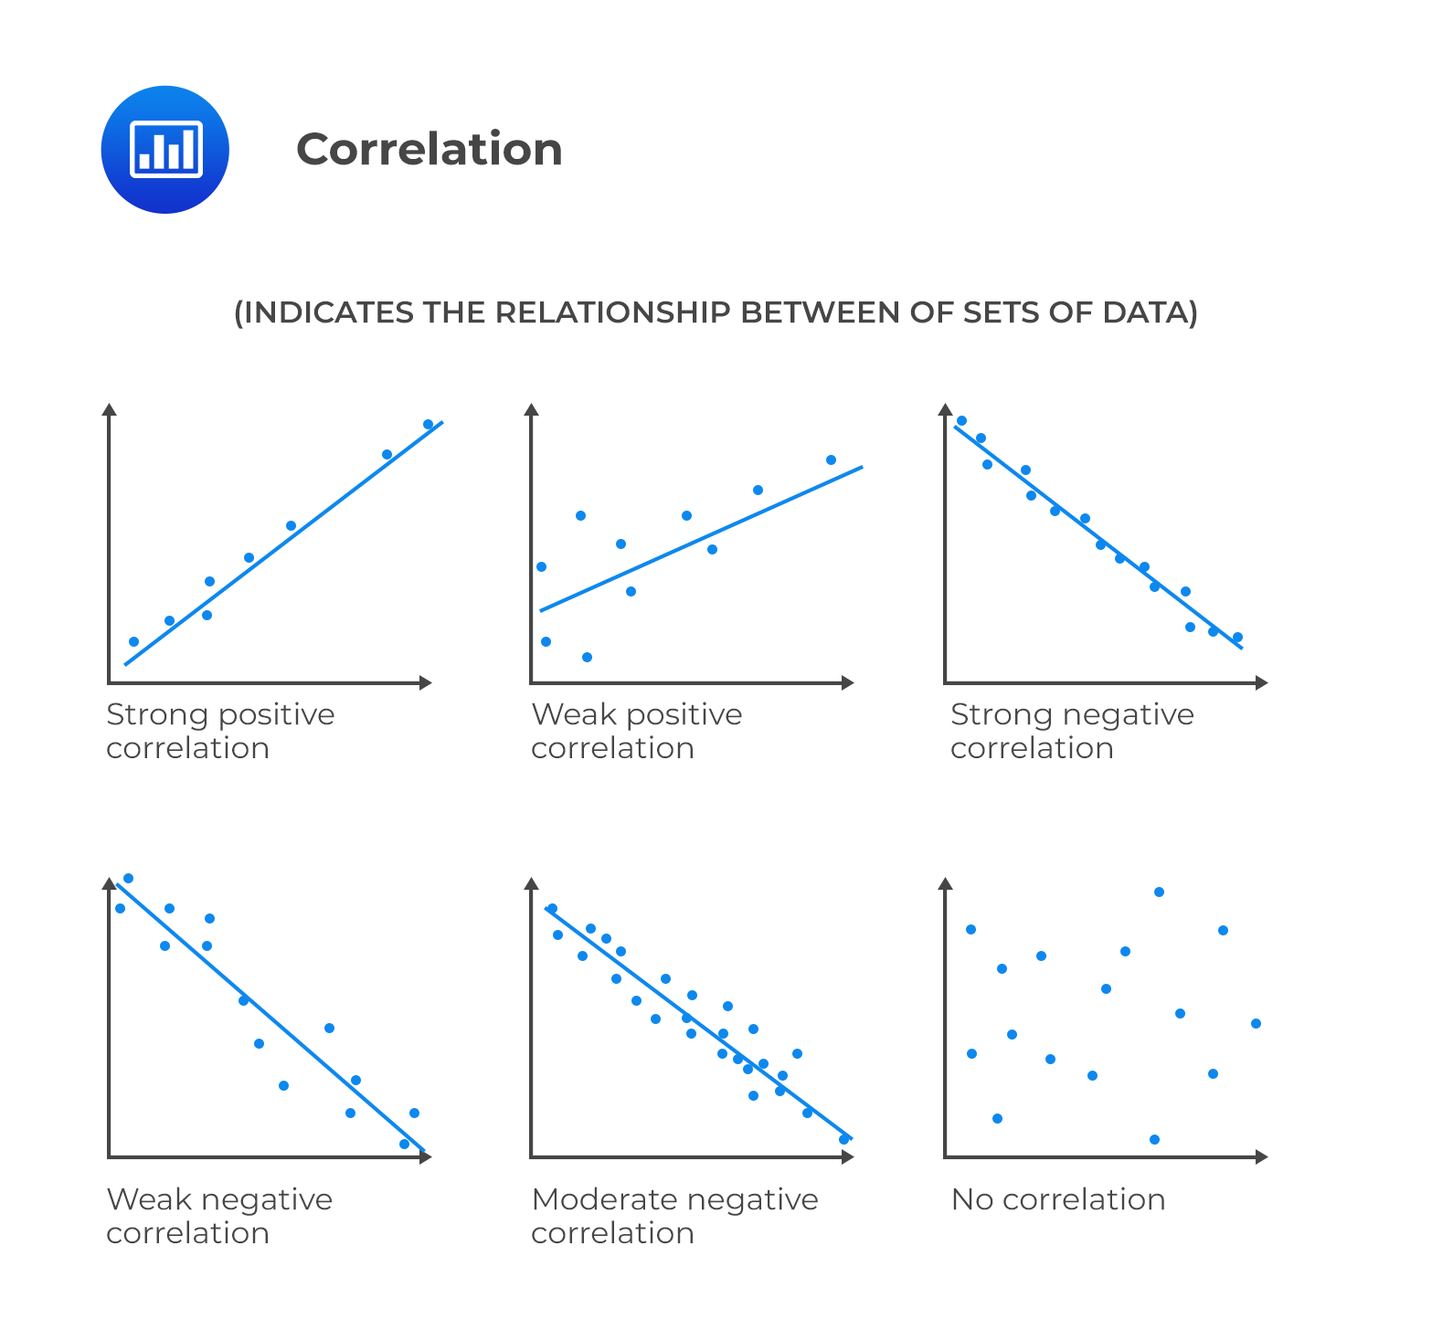
Place the correlation in the right column. Order from weakest to strongest
Positive
Negative

Slide 4
What is the most important pre-requisite needed to run a reliable correlation?
A) The data must be linear
B) The data should be ordinal/nominal
C) Your data must be replicable
D) Your data must be normally distributed

Slide 5
What is the most important pre-requisite needed to run a reliable correlation?
A) The data must be linear
B) The data should be ordinal/nominal
C) Your data must be replicable
D) Your data must be normally distributed

Slide 6
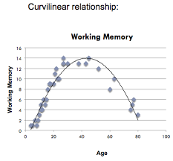
Can you run a correlation analysis on this graph?

Slide 7
Can you run a correlation analysis on this graph?
Answer: No

Slide 8
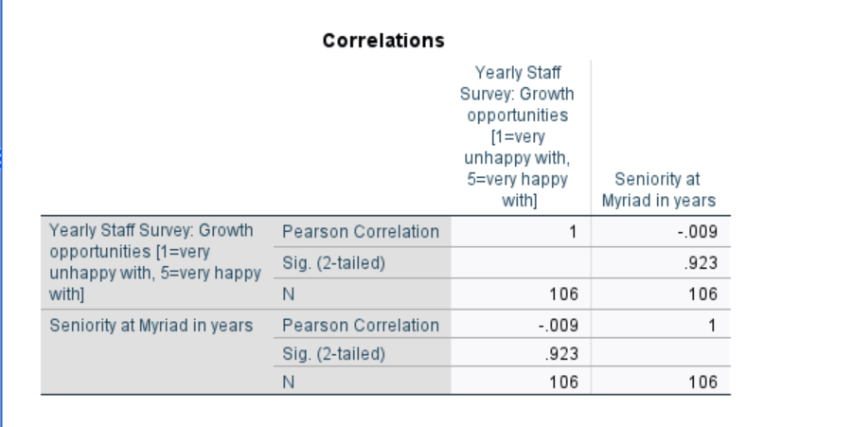
What is the correlation coefficient? What is the p-value?

Slide 9
What is the correlation coefficient? ( -.009)
What is the p-value (.923)?

Slide 10
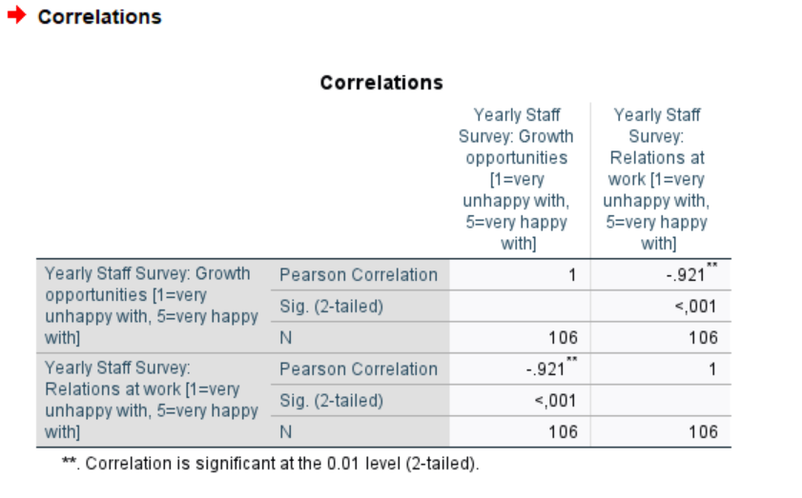
This is a strong negative correlation. What would this look like if you drew it out?

